Slide 1
CS 528 - Cloud Computing
Stop Wasting the Cloud
Mentors:
Daniel McPherson - Red Hat
Patrick Dillon - Red Hat
Team Members:
Anshu Goel
Jhukhirtha Marhi Arokiasamy
Sahil Gupta
Siddharth Bakshi
Vedant Mahabaleshwarkar

Slide 2
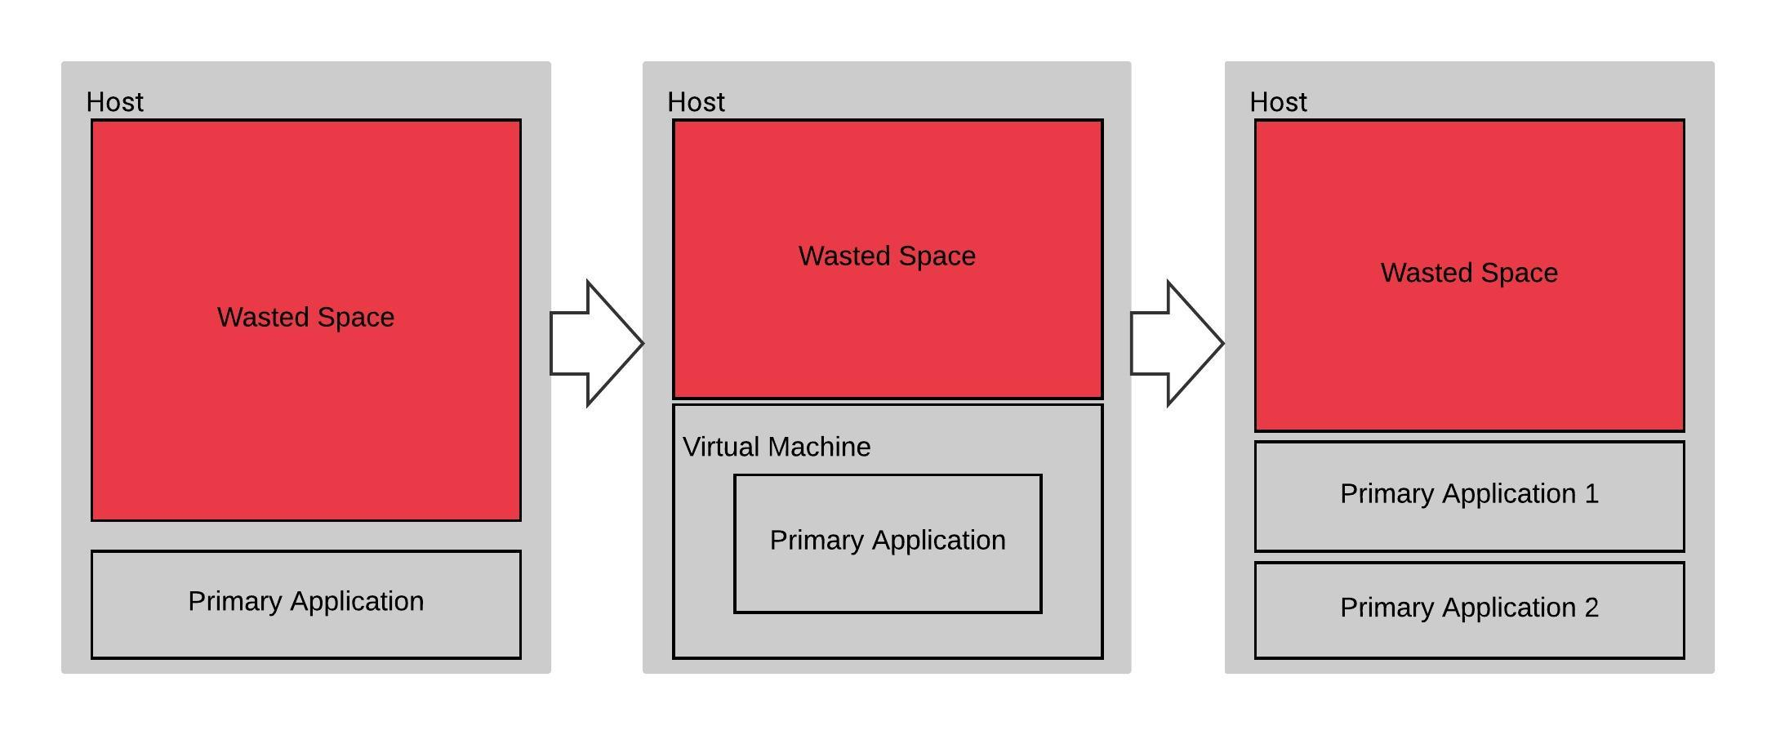
Objective
A survey shows that only 12-18% of compute capacity of cloud servers are actually utilized
Our objective is to optimally utilize the unutilized compute power by running jobs on the slack resources without affecting the performance of primary applications running on the clusters.
Notes:
Cloud technology has revolutionized the way organisations deploy their applications by allowing them to evade the capital cost of setting up the required infrastructure and only paying for renting the cloud “space”. However, a study has found out that on an average, only 12-18% of the resources that are being paid for are actually being used. Our objective is to come up with a proof of concept wherein these slack resources can be utilized to run other applications without affecting the primary load.

Slide 3






Technologies
Open source middleware system for volunteer and grid computing.
Stable Linux OS for servers
Mass Open Cloud - A public production cloud based on the Open Cloud Exchange model
Container application platform based on Kubernetes
Public computing grid to aid scientific research
Container platform
Notes:
This is the tech stack used in the project. We will be deployed our project on MOC. For node management, MOC uses Openshift, which is an open source container application platform by Red Hat based on top of Kubernetes and Docker.
In order to utilize the slack resources, we will be using BOINC, which is a distributed computing network for utilizing volunteered resources. There are a lot of research projects that use BOINC for getting the compute that they need, but in our case, we will be using World Community Grid, which requires compute for various complex computations for medical research.

Slide 4
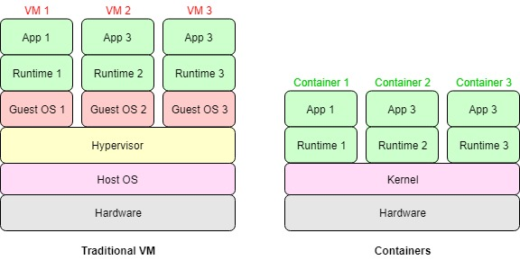
What are containers
Linux container: A set of one or more isolated processes Namespaces: To isolate processes Cgroups: To allocate system resources used by the processes
Notes:
Before we get into the details of the project, we would like to understand what containers are. In order to host multiple applications on the same hardware, the most common approach has been to utilize Virtual Machines, which are hosted on a host operating system with a hypervisor to handle the memory access. However, the recent adoption of containers take this abstraction away by leveraging Linux’s namespaces and cgroups in order to create isolated environments for processes running on the same shared kernel.
The result is an easy to manage and highly scalable setup which has a lower semantic gap with the hardware, resulting in better performance.

Slide 5
BOINC deployment strategy
There are 2 deployment options for deploying boinc containers on the cluster to consume slack resources:
Use the default Openshift Scheduler to schedule Boinc pods on nodes that are under-utilized.
Deploy boinc containers as a daemonset on the cluster.

Slide 6
Option 1 : Use the Openshift Scheduler
The scheduler decides where to deploy new pods.
New pods are deployed to nodes that have the available resources
The downsides:
BOINC might not be deployed to all nodes
More complex deployment process
Additional overhead for the scheduler
Notes:
The Openshift scheduler is responsible for determining placement of new pods onto nodes within the cluster. It reads data from the pod and tries to find a node that is a good fit based on configured policies.
Openshift scheduler deploys BOINC images whenever there is resource available in any node but the distribution of the instances among the nodes is decided by the scheduler.
It will add an additional overhead on the scheduler in figuring out when to add and move pods from nodes.
What is Persistent Volume ?
A PersistentVolume (PV) is a piece of storage in the cluster that has been provisioned by an administrator. It is a resource in the cluster just like a node is a cluster resource
PVs are volume plugins like Volumes, but have a life cycle independent of any individual pod that uses the PV.
Persistent volume would have helped us store incomplete BOINC jobs in case pod got killed. Since, we are deploying our BOINC application as Daemonset we needed shared persistent volume which is not supported by MOC at the moment.

Slide 7
Option 2 : Deploy BOINC as a daemonset
Daemonset is a feature of Openshift that deploys a pod to every node
Why it helps our case:
It ensures that we have exactly one instance of BOINC running on all nodes
Why it doesn’t:
BOINC will be killed when the other (primary) applications on the node contest for resources and the work done by it will be lost. This can be mitigated by using persistent volumes (PVs) to store the state of the BOINC application. However, it would require shared storage which can be accessed by all BOINC instances at the same time. As it stands, the implementation of PVs on MOC does not allow us to do so.
Our approach:
Deploy BOINC on every node as a Daemonset and make it less aggressive towards other (primary) applications in the cluster
Notes:
A DaemonSet ensures that all (or some) nodes run a copy of a Pod. As nodes are added to the cluster, Pods are added to them. As nodes are removed from the cluster, those Pods are garbage collected.

Slide 8
Quality of Service Tiers
QoS tiers specify the amount the resources to be allocated to a pod. Limit: The maximum resources a pod can use. Request: The minimum resources to be guaranteed to a pod.
Guaranteed: Limit and request are the same. Pod is not deployed until the resource requirements are met
Burstable: Finite limit and request needs to be specified. Pod is deployed if the request is met and allowed to consume resources upto the values specified in the limit.
Best Effort: Limit and request are not specified. Pod is deployed if the free resources in the system is non-zero and is allowed to consume resources upto the amount supported by the hardware

Slide 9
Choosing a QoS Tier
Guaranteed: Does not fit our requirements as we would need to scale BOINC’s resource usage
Burstable: A viable option to deploy the BOINC application with a very low request. May lead to under utilization if the limit is lower than the system’s hardware specs
Best Effort: Most feasible since it does not have any boundaries and can scale according to availability of resource

Slide 10
Bringing down the MOC
The amount of maximum resources a container can consume is defined by its cgroup limit which BOINC is not naturally aware of
In our first deployment, we deployed BOINC in the BestEffort tier and did not pass the cgroup value to BOINC
Result:
BOINC has unrestricted access to resources
BOINC can’t see any processes outside its container and hence assumes it can use all the resources
Apart from being counterintuitive to the project’s objective, this also led to the system admin setting a resource quota (cap) for the total resource utilization project

Slide 11
Resource Quota
Resource quota imposed to our project: Max CPU: 20 cores Max Memory: 100 Gi Max number of Pods: 20
Apart from being capped for resources, we also had to specify the limit and request for each deployment, killing our ability to deploy BestEffort pods
The workaround:
Psuedo-BestEffort: Deploy Burstable pods with very low request and the system’s hardware specifications as the limit
In order to test an entire node, deploy only on 2 nodes at a time (since each node has 10 cores and our quota is 20)

Slide 12
Tuning BOINC preferences
BOINC Client (Host)
Sends Host Hardware availability information and request for Work Units
BOINC Project Server
Sends list of Work Units along with Default User Preferences set by the Project
HTTP response and request using XML
Computing preferences that determine when and how BOINC uses your computer. Computing preferences mainly are: CPU Usage Limits, When to suspend, Day-of-the-week limits, Disk, Network Usage Limits, suspension and Day-of-the-week limits and Memory.
Customize Preferences by storing the new Preferences in XML elements
We created a 'preferences override file' in BOINC data directory. This file is read by the core client after it reads the preferences from the server, and it overrides those preferences. The preferences override file is named global_prefs_override.xml
Suspend when non-BOINC CPU usage is above N % and Use at most N % of the CPUs were customized

Slide 13
Setting BOINC’s preferences for resources
BOINC allows the user to set the maximum amount of CPU it can utilize
This was used to pass the cgroup values to BOINC to make it respect the container’s resource limits. Below are the locations where these cgroup values are stored:
CPU limit : /sys/fs/cgroup/cpu/cpu.cfs_quota_us
Memory limit : /sys/fs/cgroup/memory/memory.limit_in_bytes
These values are passed as percentage of the total resources on the node to BOINC
Note : 30% of 10 cores does not mean that BOINC will use 3 cores exclusively. It means that BOINC uses the equivalent of 3 cores on all the cores in the node.

Slide 14
Benchmarking configurations
For these set of benchmarks, we used BOINC itself to mock the existing workload on the cluster.
Primary application with 50% load:
○ No secondary load
○ Secondary BOINC - burstable upto 25%
○ Secondary BOINC - burstable upto 50%
○ Secondary BOINC - burstable upto 75%
Primary application with 75% load:
○ No secondary load
○ Secondary BOINC - burstable upto 25%
○ Secondary BOINC - burstable upto 50%
○ Secondary BOINC - burstable upto 75%
`

Slide 15
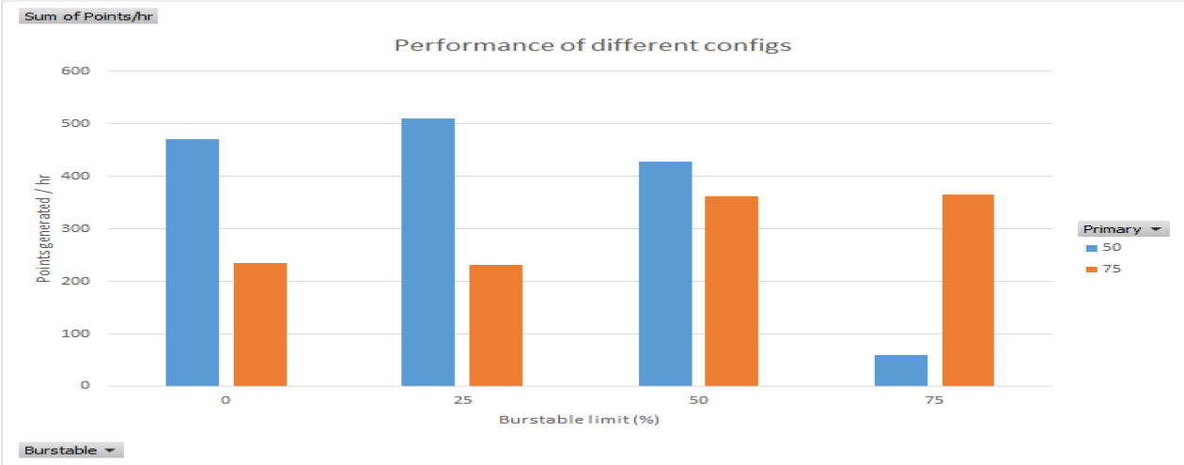
Results
X axis: Burstable percentage limit of secondary application
Y axis: Points generated per hour by primary application
Blue bar: Primary workload limit 50%
Orange bar: Primary workload limit 75%

Slide 16
Inconsistency in results
BOINC spawns processes based on the number of cores of the system
For each node, BOINC sees 10 cores, hence spawning 10 processes
But the Cgroup limits the number of threads BOINC can utilize (3 threads for a 30% limit)
This results in processes going in and out of sleep state (7 out of 10 processes in sleep state at any point of time)
WCG only awards points for fully completed tasks
Hence, even if 50 % of 10 tasks is completed, no points are awarded, even though 5 tasks worth of compute has been completed

Slide 17
Need for a different primary application
BOINC is built in such a way that it tries not to contest much with other processes
Therefore, using BOINC as both the primary and secondary load led to unpredictable behaviours from both the primary and secondary applications, which were both BOINC
Hence, in order to get consistent benchmarking result, both primary and secondary applications cannot be BOINC

Slide 18
New primary application: sysbench
Sysbench is a linux utility that is designed to benchmark hardware.
Sysbench’s cpu test spawns multiple threads and calculates the count of prime numbers upto 100k on each thread
Each time the count is generated, it is counted as an event. Sysbench outputs the number of events per second
Monitoring BOINC’s effect on the primary application would be done as follows.
Get the number of events per second when boinc was not running along with the primary
Get the number of events per second when boinc was running along with the primary

Slide 19
New benchmarking strategy
Node 1: Primary application with workload of 70%
Node 2: Same as node 1 and running BOINC job with burst-able limit 60% while passing min(.8, log((burstable limit percentage/total cores on the node) + 1.4)) * total_cpus_of_machines in BOINC config file.
Note : The formula ensures that it takes up tasks worth slightly more than it’s cgroup limit, to ensure that we are never run out of tasks for BOINC to compute

Slide 20
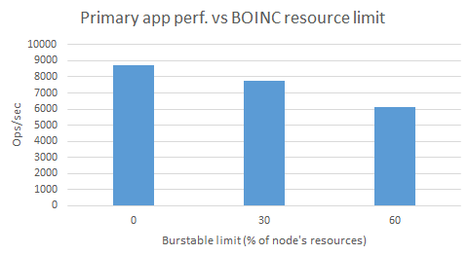
Results
X axis: Burstable Limit of BOINC (secondary application)
Y axis: Number of events of primary application in logarithmic scale

Slide 21
Problems with BOINC not suspending itself
In order to avoid CPU contention, the BOINC app needs to consume less resources when the primary application starts consuming more
BOINC has an option to suspend itself if non-BOINC load exceeds X%
However, we observed that BOINC never suspended itself even though non-boinc load exceeded X% specified in the configuration file

Slide 22
Problem with propagating non-BOINC resource usage to BOINC
In a local machine environment where BOINC co-exists along with other processes as an application, it is easily able to suspend when the non-BOINC workload on the machine is high.
BOINC generates a process map of all the processes running on the machine, and adds up the utilization of its processes to generate BOINC’s total CPU utilization.
It sums up the utilization of all the other processes to generate the value for non-BOINC cpu utilization.
However, in a container environment boinc can only see the processes inside its container, hence cannot see non-boinc workload. This leads to boinc never suspending even when non-boinc workload is intensive.

Slide 23
Possible Solutions
The obvious solution is to develop an external controller at a scheduler-level (e.g. VPA) to kill/compress pod when non-boinc usage exceeds X%. It is possible to look into total resource usage of the node from outside of the container.
Using a python utility called psutil, we verified that it was possible to see the total node usage from inside a container. This opened up two more solutions
Build a wrapper around BOINC, inside the container which would suspend BOINC when non-BOINC usage exceeds X%
Make changes to BOINC source code itself to make sure that the inbuilt option to suspend works in a container environment also.

Slide 24
Problem with solutions 1 & 2
Scheduler-level controller:
Highly complex to develop
Pods will be killed rather than suspended
Complex deployment, may steer away people from adopting it
Wrapper around BOINC:
Processes managing other processes not recommended
If it is possible to build such a wrapper, then it is possible to make the changes inside BOINC
Notes:
Building a controller at a scheduler level is possible but ramps up the complexity significantly. Also, it will not be as efficient as BOINC pod will get killed rather than getting suspended. This added complexity also means that using BOINC in a container might be too cumbersome for many people to take on, potentially limiting its usage.
Developing a wrapper around BOINC is not recommended. It is anti-pattern for one process to manage other process inside the container. Furthermore, if it is possible to build such a controller, it is also possible to make the changes into BOINC itself, which is a more robust solution.

Slide 25
Changes made to BOINC’s source code
For linux kernels, the total CPU utilization is available in the ‘/proc/stat’ file, which any process can read.
Thus, even though boinc cannot see other processes running on different containers, it can definitely see the total machine utilization by reading the “proc/stat” file.
The original boinc code to calculate BOINC’s cpu utilization works even in a container environment because it can see its own processes.
Making use of this information, we change the way boinc calculates non-boinc cpu utilization as follows : Non-boinc cpu utilization = total machine cpu utilization - boinc cpu utilization.

Slide 26
BOINC being responsive to non-BOINC jobs
After making changes to the BOINC source code, all BOINC instances were running as expected when there was no other primary application running on the same node
BOINC was able to suspend itself when a primary application was deployed using more than X% resource of the node.
These changes helped BOINC stop consuming the node’s resources when required without getting killed

Slide 27
Demo

Slide 28
Future Work
As of now BOINC does not dynamically scale itself to consume resources depending upon the varying load of the primary application, rather it only suspends itself. Further improvements can be done to make BOINC more optimal.
Currently to apply any changes to User Preferences, the container has to be built again. Whereas, the paper below proposes an Optimization Middleware to dynamically adjust and update the global preferences file according to the constantly changing nature of its running environment. (Mnaouer, A., & Ragoonath, C. (2010). An Adaptive Priority Tuning System for Optimized Local CPU Scheduling using BOINC Clients)

